Slide 1
Gender dimensions of taxation
Gender bias in taxation
Explicit: the tax code explicitly treats women and men differently
Implicit: taxation affects differently women and men because it operates in a gendered economic terrain.
Gender tax burden: how tax burden is allocated to women and men or to male and female type of households (for example, male breadwinner vs single-parent households).
How taxation affects individual behaviors (for example, economic participation) and therefore how it affects gender relations.

Slide 2
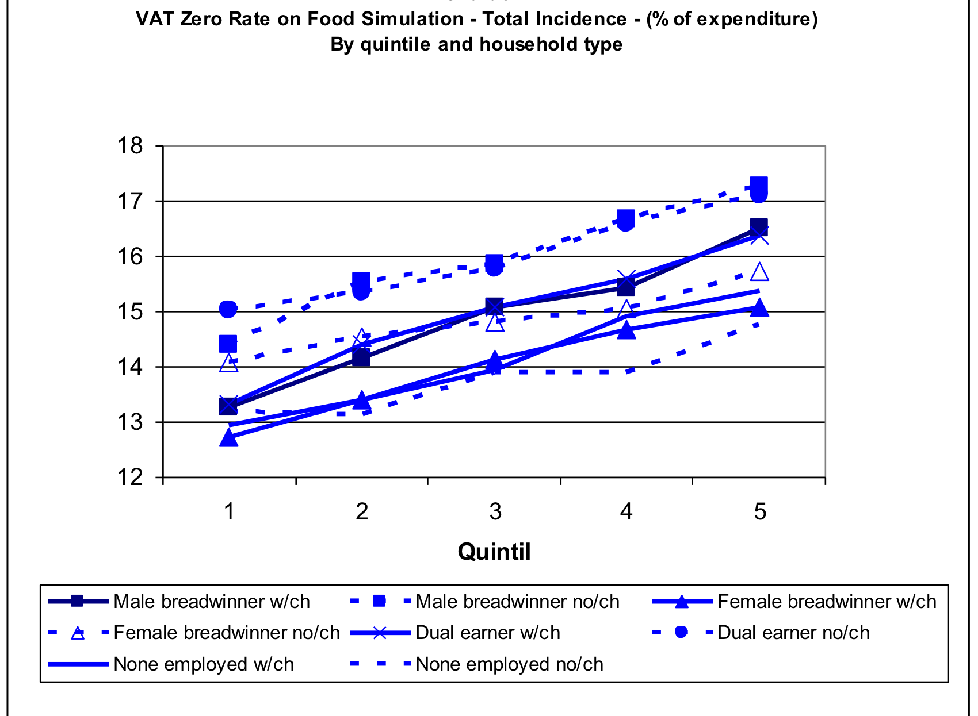

Slide 3
What kind of taxation system should feminists advocate for?
Principles:
Distributional impact of tax policies should be by income group but also by gender
Impact of tax policies should be assessed both on paid and unpaid work
Tax policies impact on gender relations within households should also be assessed
Tax reform should:
Increase revenue through progressive and non-bias taxation
Avoid evasion and avoidance, by taxing corporates and financial flows
Promote behavioral changes that transform existing gender relations
Foster citizens´ participation in tax policy design and monitoring

