Slide 1
NEW ACTORS, NEW MONEY
& NEW CONVERSATIONS
Mapping The Current Landscape & Potential Resources
For Women’s Rights
Results & Analysis
MAY 2014 www.awid.org
Notes:
The purpose of this report is to contribute to filling a gap, particularly among women’s rights organizations, in understanding the current landscape of corporate sector and other actors ‘new’ to supporting women and girls, and the role they are playing in shaping related funding discourse and practice. This report is not an exhaustive account of these actors’ involvement in development funding, but it unpacks some of the most visible trends impacting women and girls – the ‘tip of the iceberg’ as it were – and offers important considerations for women’s rights organizations interested in influencing and engaging with these trends.

Slide 2
Overview of the Presentation
MAY 2014 www.awid.org
Research Methodology
Context
Key Findings
Potential Challenges
Finding Opportunities for New Conversations

Slide 3
Research Methodology (1)
MAY 2014 www.awid.org
In-depth Interviews (January – March 2013)
24 resource people discussed recently emerged initiatives, players and spaces supporting “women and girls.”
We're learning that the private sector has a wide range of motivations to support women and girls, sometimes it's to help clean up their reputations, to join a trend, [to create a bigger supply chain or because they genuinely want
to support women and girls.]
“
”
Notes:
This research was undertaken in collaboration with Mama Cash and supported by the Dutch Ministry of Foreign Affairs.

Slide 4
Research Methodology (2)
MAY 2014 www.awid.org
Desk Research (January – March 2013 and May – July 2013)
Developed more detailed analysis on the initiatives supporting women and girls
Key criteria established
Sources included: online research, suggestions from interviewees, and the CGI commitments list
Initiatives included in the Desk Research had the following criteria:
With a Development Objective | Current / Planned through 2018 | Focused on Women and Girls | New or Innovative Actors / Mechanisms

Slide 5
What is the Context?
MAY 2014 www.awid.org
Young Women Leaders
Agenda Setting Spaces
Women of Wealth
Interest in Women and Girls
Newer Corporate Foundations
Impact Investing
Crowd Funding
Newer Private Family Foundations
Private Sector Engagement
Celebrities on Board
INGO Campaigns
Corporate Social Responsibility
New Private Sector-CSO Partnerships
Social Media
Notes:
What is ‘new’ in the Current Funding Landscape?
Crowd funding: Technology is being harnessed and utilized like never before, mobilizing the public to directly fund initiatives around the world with the click of a button. One new crowdfunding site, Catapult, was developed at Women Deliver as “the first funding platform dedicated to gender equality,” facilitating support for women’s organizations on the ground.” Crowdfunding presents an opportunity to broaden the resource base by democratizing and moving philanthropy away from the hands (wallets) of the few to the hands (online clicks and sometimes wallets) of the many.
Impact investing: First coined in 2007 as a term, impact investing has caught on among global corporations and is predicted to grow up to US $500 billion in assets by the end of this decade. It is an investment trend in companies, organizations, and funds with the intention of generating positive social and environmental impacts in addition to financial returns. The Social Impact Investment Taskforce, comprised of public and private-sector representatives from the G8 countries, will offer recommendations for the private sector to help accelerate impact investing and lead to “not just aid, not just trade, but investment.”
New platforms of convergence and agenda setting: For many of the ‘new actors’, new platforms have developed as spaces for convergence and agenda-setting. The Clinton Global Initiative (CGI), Women Deliver Conferences, Women's Forum for the Economy and Society, and the World Economic Forum, among others, are increasingly setting the tone and agenda for discussions about funding for women and girls and around broader development issues as well. These spaces not only convene newer actors in development financing, but more traditional funders as well. Historically, many of these spaces have not had a strong presence of women’s rights organizations and movements, but that appears to be shifting in the past few years.
Women of wealth are getting on board: With increasing numbers of women reaching the highest levels in business and the professions, starting their own businesses and inheriting significant wealth, women of wealth are increasingly becoming more involved and regarded as significant players in philanthropic and development agendas
Young women playing diverse leadership roles: Innovations are coming from young women leaders who are creating their own spaces for organizing and activism, using digital technology and media spaces in creative ways to move women’s rights agendas forward. One example, is FEED started by Lauren Bush and Ellen Gustafson in 2007, working with the United Nations World Food Program, “which manufactures and sells reusable bags, [and bracelets, t-shirts and backpacks] that resemble feed bags with half of the proceeds going towards feeding the hungry.”
Celebrities are increasingly involved in causes related to women and girls. America Ferrera, Ashley Judd, Salma Hayek, Angelina Jolie, Beyonce and Nicole Kidman, among others, are contributing to causes by lending their voices to create a following and raise awareness about the importance of an issue.

Slide 6
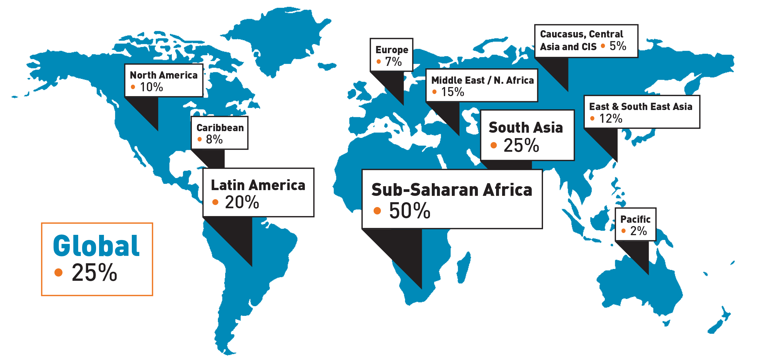
The Initiatives: Where, How Much?
MAY 2014 www.awid.org
170
Initiatives
$14.6
BILLION
DOLLARS
Each initiative may have more than one region

Slide 7
Initiative Sizes
MAY 2014 www.awid.org
Base: 147 initiatives
23 had no amounts listed
Notes:
The average initiative size over an average five-year period was USD 123 million; the median was USD 3 million, with a total of USD 14.6 billion pledged to women and girls. This raises important questions about who is positioned to engage in these partnerships given the median size of the initiatives.

Slide 8
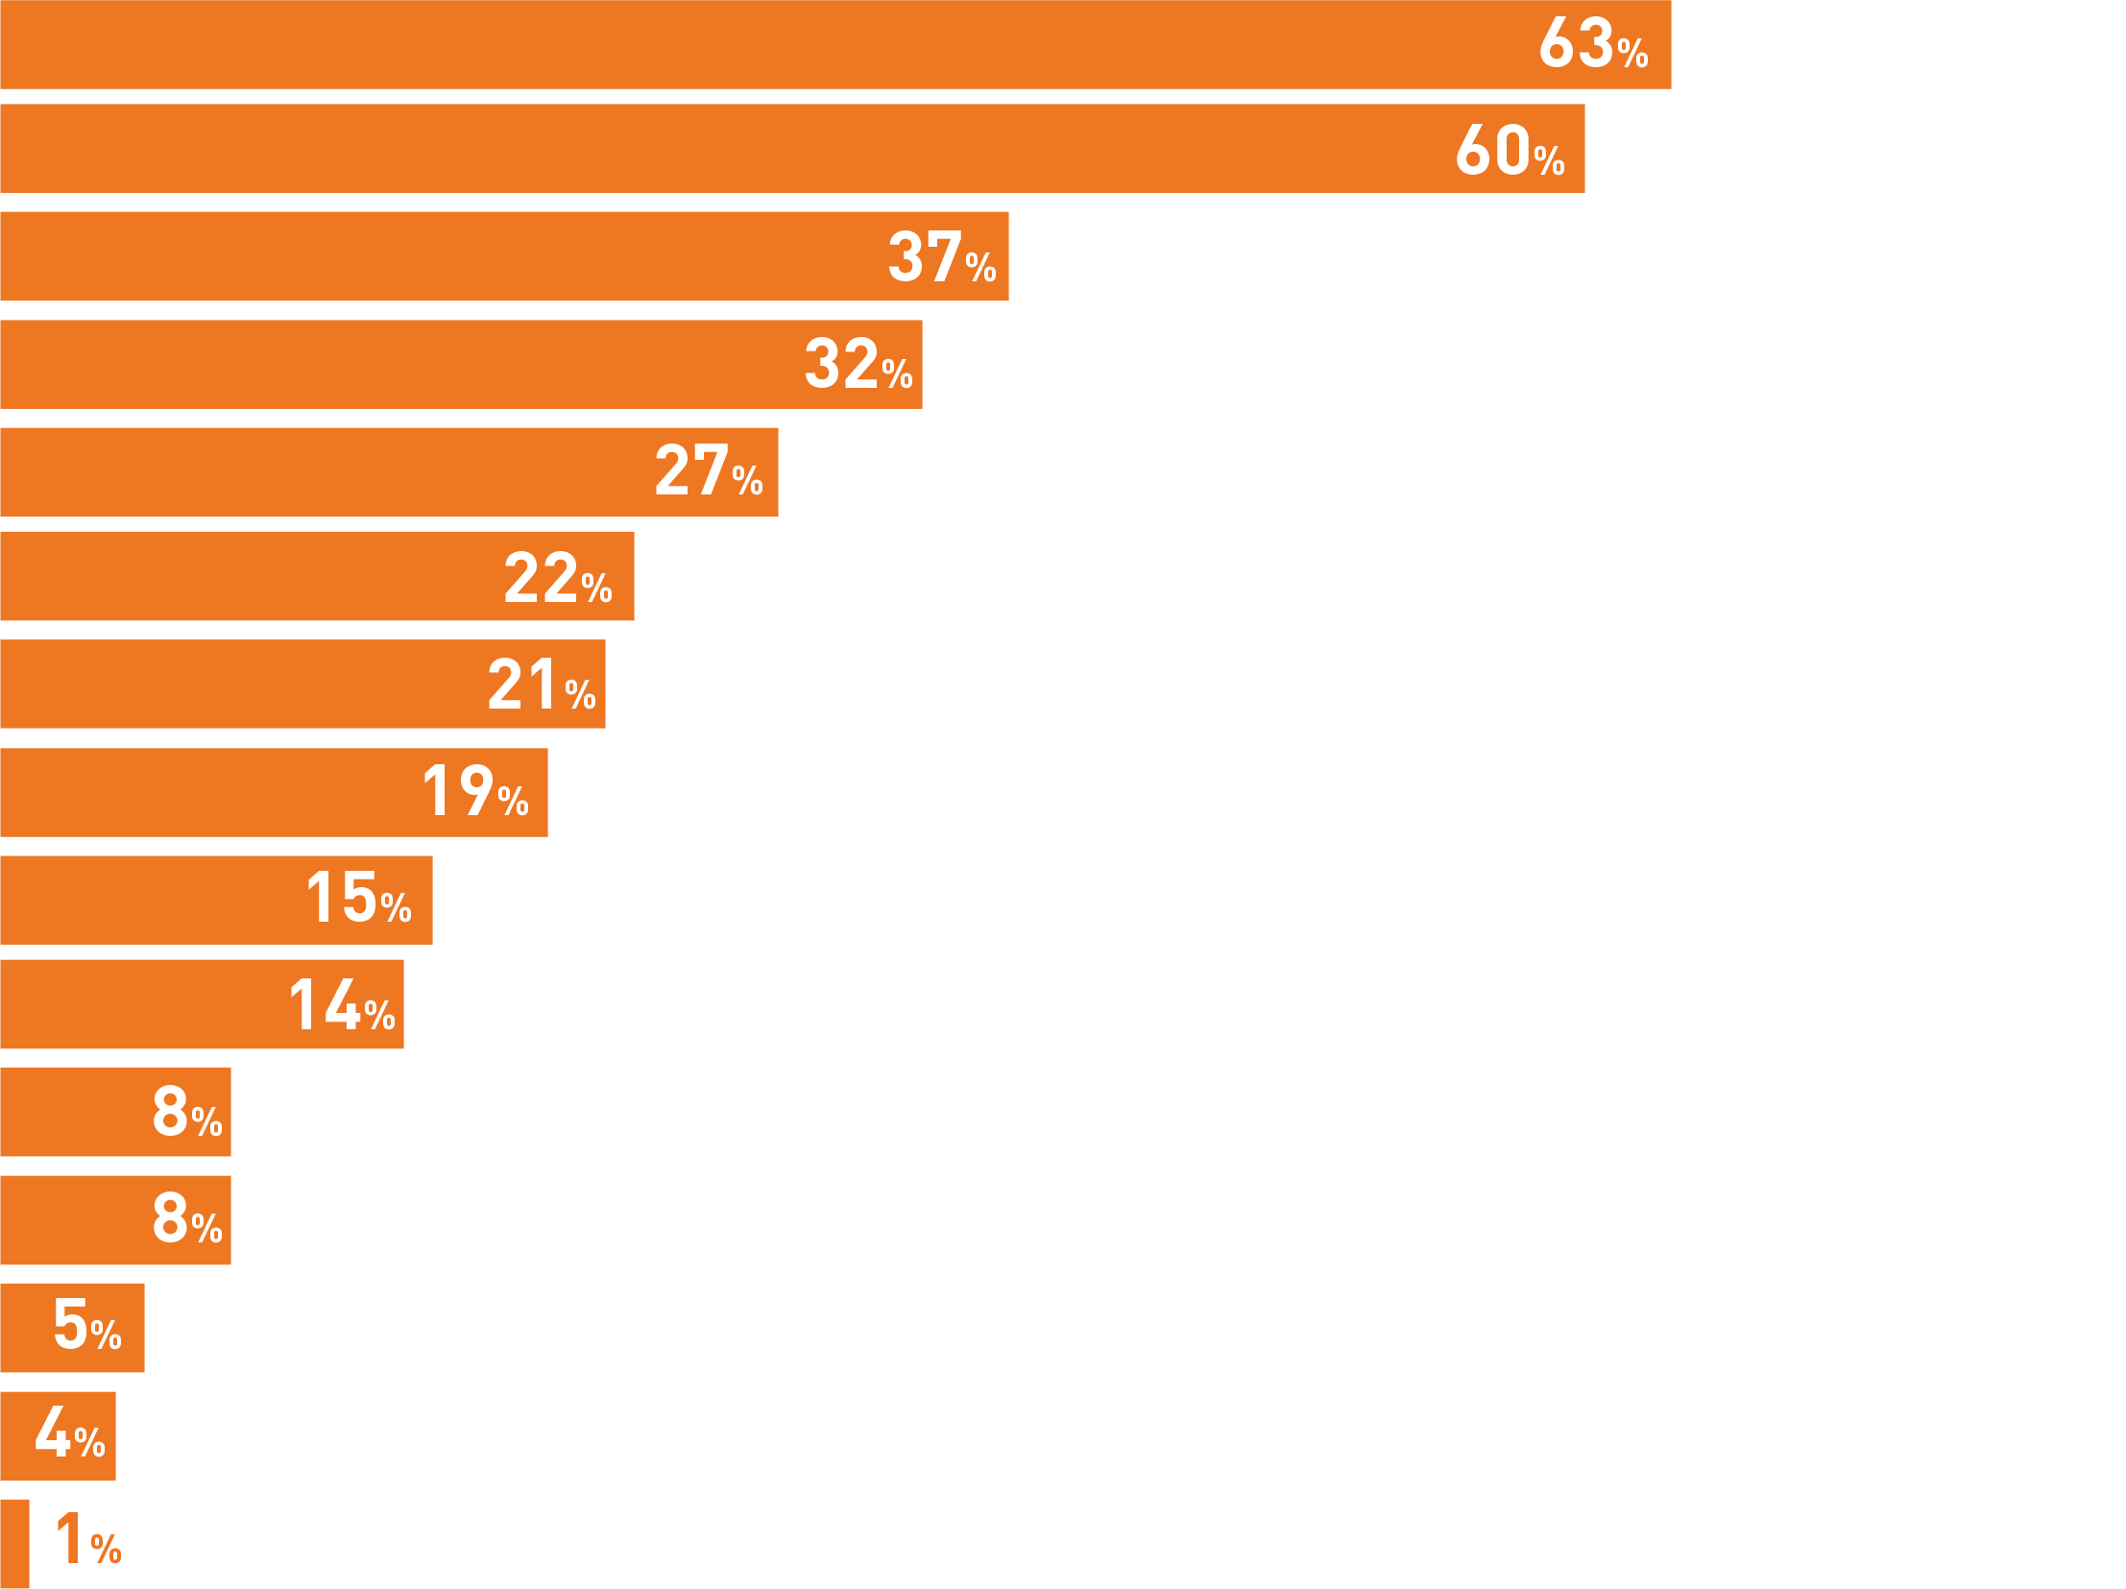
Who is Involved?
MAY 2014 www.awid.org
NGO (35%) / INGO (28%)
Corporate Sector Actor
Public/governmental Institution (including Bilateral Agency)
Newer Private Foundation
Women's Organization
Multilateral Agency
Academic Institution
Established Family Foundation
Established Corporate Foundation
Newer Corporate Foundation
Private Individual
Microfinance
Celebrity
Base: 170 initiatives
Each initiative may have more than one type of sponsor.
Results will not total to 100%.
Media
Crowd Sourcing Platform
Notes:
The most common type of actors involved in these partnerships are non-governmental organizations (63%, of which 35% are NGOs and 29% are international NGOs that are not explicitly “women’s organizations”) such as Plan International, Oxfam International and World Vision.
Corporate sector actors such as Exxon Mobile and Coca Cola (60%) followed next, further affirming the interest from this sector in financing, managing, and implementing development programs and initiatives relating to women and girls.
Public/government institutions - which are among the traditional sources of support for women and girls - followed at 37% and included 9% of bilateral development agencies.
Multilateral agencies, academic institutions and others were involved in 20% or fewer of the partnerships mapped.
Women’s organizations were involved in a partnership in 27% of the cases, though available data indicates that only 9% of women’s organizations received “direct support.”
Public government agencies were only included if they partnered with other actors in a way that is reflective of this trend i.e. DFID partnering with NIKE for the Girl Hub.

Slide 9
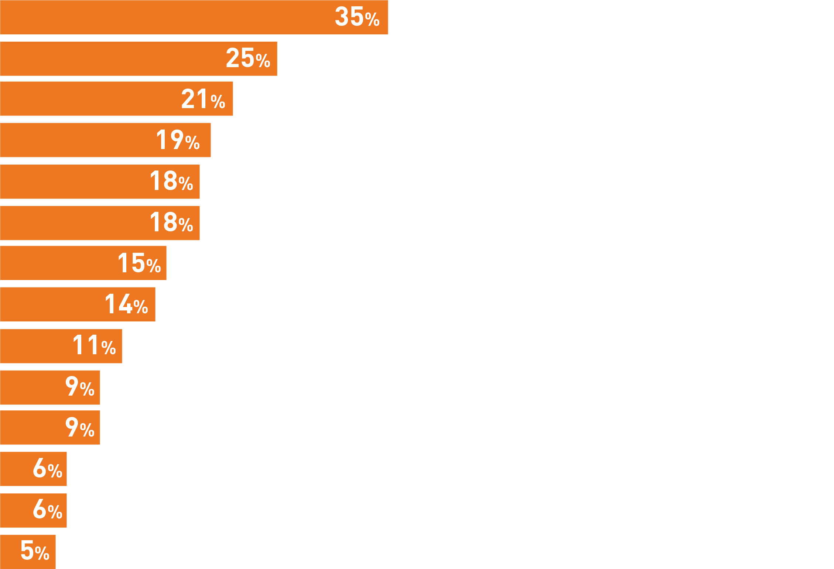
Thematic Focus of the Initiatives
MAY 2014 www.awid.org
Women's Economic Empowerment and Entrepreneurship
Women's Leadership and Empowerment
Education for Women and/or Girls
Health For Women and Girls
Public Health for Women and/or Girls
Maternal Health
Sexual and Reproductive Health and Rights
Women, Media, Technology/Communications
Women's Rights
Violence Against Women and Girls
Public Health
HIV and AIDS
Food and Nutrition
Human Rights
Peace and Conflict
Base: 170 initiatives
Notes:
Examples of Initiatives:
Women’s Economic Empowerment and Entrepreneurship:
Dream Builder: The Women’s Business Creator: an initiative by mining company Freeport-McMoRan Copper & Gold Inc. They state “in recent years, a growing body of research demonstrates that investments in women in particular yield many multiplier effects, not only the effect of growing small businesses to generate economic benefit, but also the effect of applying increased income to reinvest in the foundations of sustainable communities such as their children's education, healthcare for their families, etc. thereby raising the overall wellbeing in the community.” The initiative has dedicated USD 3,900,000 to focus on building an online Women's Business Academy that includes business skills training to 3,400 entrepreneurs. By using a distance learning web-based format, it aims to provide women entrepreneurs with knowledge and skills that they will continue to strengthen after their certification with peer support. This enables women “to source information and to build their supply chain.”
Women’s Leadership and empowerment - Led by Oxfam International, the Department for International Development (DFID) along with Equality Now, Oxfam America, and the Women’s Legal Circle. “Phase II of Raising Her Voice program,” focuses on addressing the structural barriers to women’s rights for full political participation and leadership. The program aims to improve conditions for 140,000 women by dedicating USD 9,400,000 over three years to advocating for women's political participation and leadership. The progress is motivated by the sponsors’ concern over the fact that worldwide, just 19.3% of elected Parliamentary representatives and just 16 of 188 national leaders are women.
Education for women and girls - 10x10: Connect the Dots, Educate Girls, Change the World, is a film and social action campaign that aims to inspire individuals to take action to support girls’ education, with an estimated total value of USD 10,977,766 from 2010-2014. Individuals can become involved by screening the 10X10 movie, donating to the Girls Rising Fund or “joining the movement” for girls’ education. Shelly Esque, Vice President of Intel Corporate Affairs Group and President, Intel Foundation explains that part of the driving motivation for Intel to be a founding partner in the initiative relates to “overwhelming evidence that investing in adolescent girls in the developing world creates transformative change for families, communities, and entire countries.”
Health for Women and Girls One USD 10,000,000 initiative, Bringing Hope to Rural Tanzanians, led by the Benjamin William Mkapa HIV/AIDS Foundation, the Government of Tanzania and mining company, African Barrick Gold, was developed in “response to research showing that despite high attendance to antenatal care in Tanzania, only 42 percent of women deliver in health facilities in rural areas compared to 82 percent in urban areas. “At least 8000 women in Tanzania die from preventable pregnancy-related conditions, and 32 newborns die out of 1000 live births every year.” As a result, the four year initiative is committed to “strengthening and expanding HIV and AIDS care and treatment, emergency obstetric care, and prevention of mother to child transmission of HIV services in rural areas of Tanzania. This includes supporting the clinical, leadership and management skills of at least 1500 health staff, and the construction and equipment of 30 operating theatres for quality service delivery.”

Slide 10
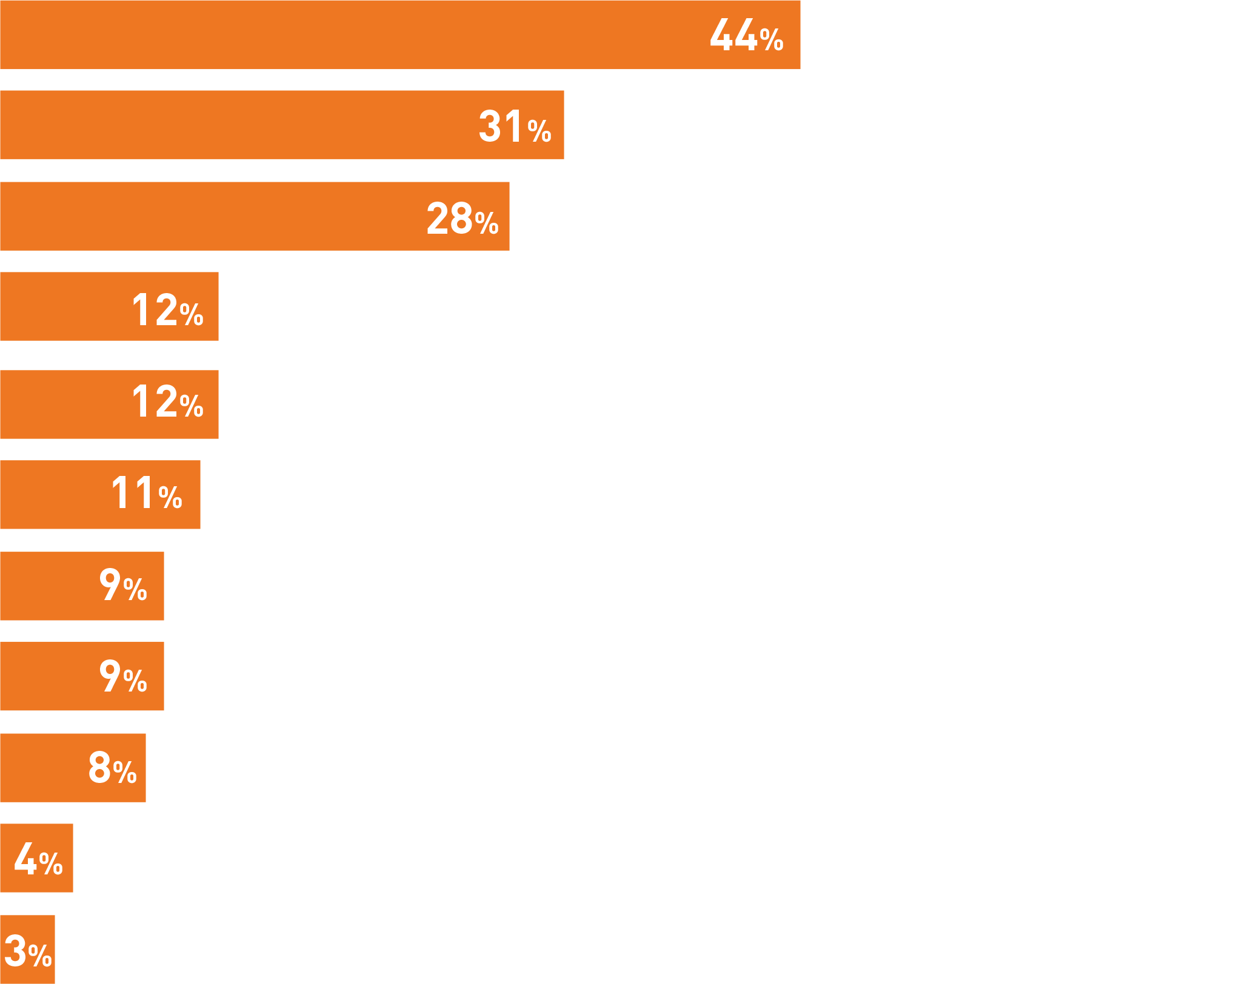
How Support is Disbursed
MAY 2014 www.awid.org
Training and Technical Assistance
In-Kind Services and Contributions
Resourcing and Launching their Own Initiatives
Microcredit / Microfinance
Direct Funding to NGOs (Other Than Women's Organizations) Who Support Issues for Women and Girls
Direct Funding to Schools or Tuition Support / Scholarships
Direct Funding to Women's Organizations
Partnership with a Non-Profit (Sharing Expertise)
Shifting Corporate Practice to Engage More Women in the Supply Chain, Expand Business for Women Entrepreneurs
Direct Funding to Social Entrepreneurs
Shifting Corporate Practice to Engage More Women in Leadership Positions
Notes:
Training and Technical Assistance: This includes programs that focus on training women and girls to equip them with a particular skill or set of skills, or technical assistance that includes advice, assistance to maintain or implement a program. For example, the Cherie Blair Foundation together with Google Inc., London Business School, United Nations Development Programme (UNDP), U.S. Department of State, National Entrepreneurship Network and Clutterbuck Associates, started the Mentoring 1,000 Women Entrepreneurs initiative, committing USD1,800,000 over two years, “targeting women small business owners to provide mentoring over the internet to equip women with business skills, technological expertise, access to capital, and an increase in confidence, with the aim of ultimately leading to improved business performance.” During the last year the Foundation supported 400 women in 50 countries and found that “more than 40% were able to launch a new business or expand their current business after eight months of working with their mentor. In their survey, 22% hired new employees and 25% gained new clients.”
In Kind Services and Contributions: In-kind contributions refer to goods or services that an initiative provides the intended beneficiaries, as distinct from a cash payment or grant. For example, initiatives such as 10x10, discussed above, allow individuals to donate goats, chickens and other livestock.
Resourcing and Launching their Own Initiatives: Almost one-third of the 170 initiatives supporting women and girls that we examined chose to resource and launch their own independent efforts in the form of a new initiative, program, meeting or research that ultimately aimed to benefit women and girls in some way. We created this category of initiatives when we could not clearly identify a particular distribution mechanism (such as training, in-kind support, direct funding, etc.) One example is the Girls for a Change initiative, which creates programs to “inspire girls to have the voice, ability and problem solving capacity to speak up, be decision makers, create visionary change and realize their full potential.” They have created over 100 Girl Action Teams to implement a social change project that will make a lasting change in their neighborhood, city or school, with over 25 corporate partners such as the Kimberly Clark Corporation, Microsoft, Yahoo, among others.
Microcredit/ Microfinance: Microcredit has been a popular—if much debated—strategy among many development institutions. An example of an initiative includes one organized by the Brazilian bank, Itaú Unibanco, which provides access to tailored financial products and services to 1,500 women-owned small and medium enterprises (SMEs) in Brazil, with the objective of increasing their revenues and expanding job creation. “With financial support from the InterAmerican Development Bank Group totaling US $550,000, Itaú Unibanco is designing a new loan access process for women-led SMEs that incorporates measures of the entrepreneurs’ attributes and personalities, not only their credit history and collateral.” They are also aiming to link this program to the Goldman Sachs Foundation’s 10,000 Women Program to provide a “dealflow” that is, program graduates to feed into the implementation of this project.
Direct Funding to NGOs: In order to support understanding the impact of these initiatives on women’s organizations, we distinguished between those directly in support of women’s organizations and those in support NGOs who work on issues for women and girls. An example of initiatives focused on direct funding to NGOs or INGOS who did not self identify as women’s organizations but had programs focused on women is the corporate support by such donors such as BIRKS, UNIGLOBE Western Travel and Danier Leather directly support Plan International’s Because I am a Girl, which is a “global initiative to break the cycle of poverty and gender discrimination.” In 2012 alone, Because I am a Girl listed expenditures (including development programs related to this Campaign) of over USD 96,000,000.

Slide 11
Potential Challenges with these initiatives (1)
MAY 2014 www.awid.org
“
”
By focusing on one aspect of education such as scholarships, it won’t be beneficial if the legislation isn’t being looked at,
if the school system is failing girls,
and they are subject to violence and without toilets.
A narrow thematic issue focus
Focus on the individual: Not addressing structural or systemic factors
Limited approach to change: Focus is not on a rights-based approach, instead quantifiable results and “quick wins”
Notes:
A narrow issue-focus: Many of the ‘new initiatives’ focus on a particular problem or issue—access to education, livelihoods, etc. — and in some cases, a very narrow slice of that issue, such as a focus on contraception within the broader umbrella of sexual and reproductive health and rights. While no one initiative can do everything, these interventions may not have the intended impacts, precisely because they have overlooked the interplay of other factors. For example, many microfinance programs do not address the fact that men and social norms still exert significant control over the lives and livelihoods of women. In India, for instance, there are now widespread reports of increased violence against women beneficiaries of micro-credit projects (because men cannot get access to small loans), there are also stories of women committing suicide linked to the growing pressure of their indebtedness, caused by increased hours of work to meet loan repayments, while still maintaining their other gendered roles (childcare, housework, care of the aged).
Focus on the individual: Many of the initiatives included in the mapping focused on reaching individual beneficiaries, for example: scholarships for girls, business training for women, and access to medical services. The programs emphasize how providing an individual with a particular opportunity or resource will catalyze broader change in their schools or communities. Although this makes sense from a “return on investment” perspective, it can overlook that women and girls as individuals are worthy of rights in and of themselves, as well as the structural or systemic factors beyond an individual’s control that are impacting on her life and the problems she faces. For example, in the case of women’s health, programs that build clinics or increase pre-natal care are valuable, but without considering larger realities of budget cuts in public health systems, and the rolling back of legislative gains and international agreements regarding women’s reproductive and sexual health and rights, their gains may be fleeting.

Slide 12
Potential Challenges with these initiatives (2)
MAY 2014 www.awid.org
Women’s rights organizations not on the radar: Limited relationships, yet women’s organizations are critical to informing effective strategies from past experience and learnings
Full operations of a particular actor are not always coherent and consistent with the stated social mission
The one key problem we need to address is that the internal behaviour of a corporation is not necessarily linked to the external behaviour of the foundation arm. There needs to be an evolution in the thinking of women’s organizations to ensure these different changes are more connected, and demanded.
“
”
Notes:
Women’s rights organizations not on the radar As the world speaks of the power of ‘investing in women’, the experiences and perspectives of the organizations that have historically been closest to transforming the position of women and girls in societies should be a major force shaping this discourse. Yet only around 27% of the 170 initiatives supporting women and girls engaged women’s organizations as partners, and only 9% directly funded them (compared to almost one-third of the initiatives that launched their own independent efforts).

Slide 13
Opportunities for New Conversations
MAY 2014 www.awid.org
Collective Engagement, Allowing for Diverse Roles
Compatibility of Purpose
Room for Negotiation
Mutual Respect
Notes:
Without stronger efforts from women’s rights activists to inform and influence this trend, it will continue to take directions that minimize the historic role and value of women’s rights movements and collective action and mobilization for human rights. AWID and Mama Cash propose:
Collective engagement, allowing for diverse roles: It is important for women’s rights organizations, women’s funds and other allies to find ways of navigating this terrain collaboratively, with a view to opening space for others and ‘expanding the pie’ of available resources (not benefiting just individual organizations). At the same time, not all women’s rights organizations are well-positioned to engage with new actors. This is why collaborative resource mobilization and a role for strategic intermediaries like women’s funds and larger women’s rights organizations are key.
Compatibility of purpose: The top five themes reflected in these initiatives echo dominant development priorities, and can certainly be embraced as important areas for further work and attention—indeed they are areas of focus for many women’s rights organizations as well. The real opportunity for meaningful, catalytic partnerships between new actors and women’s rights organizations will most likely lie in making the connections among these objectives, allowing both sides to learn from one another. If women’s rights organizations are clear on their non-negotiables for engagement, they can inform decisions about the extent to which shared purpose exists and presents and opportunity for useful collaboration.
Room for negotiation: Collaboration between women’s rights organizations and corporate sector actors have usefully advanced the interests of both sides. These successes have tended to emerge from dialogue to shape the collaboration—without one side being the ‘implementer’ of another’s project. In a funding landscape where many women’s rights organizations say it is increasingly difficult to convince donors to support crucial work linked to networking, convening, rapid response to emerging crises, and communications, space to negotiate ‘what matters’ and ‘what works’ is key.
Mutual respect: Unhelpful stereotypes abound on both sides — and how could they not given the limited interaction between these two ‘worlds’. AWID and Mama Cash’s experience in this mapping and related research to date has introduced us to an array of women (and men) from the corporate sector and other new actors who are genuinely interested and committed to meaningfully support women and girls’ empowerment. It would seem that more attention needs to be given to cultivating partnerships as well understanding and recognition that these groups speak different languages.

Slide 14
Finding Opportunities (1)
MAY 2014 www.awid.org
Create an effective communication strategy
Message the importance of women’s rights and women’s organizing in a compelling way to actors not familiar with the work
At the end of the day,
if we really want to move the needle,
it’s about how to talk about women’s rights to
an audience thinking about bottom line.
“
”
Notes:
Create an effective communication strategy: Women’s organizations need to be able to message the importance of their work to a broad set of actors, this includes articulating the impact that decades of women’s rights organizing has achieved.
A coherent approach: Labour unions and labour rights activists have been critically engaging the corporate sector for decades. If women’s rights activists are to venture into this somewhat unknown territory, it is crucial to do so in a way that is as well-informed as possible by the on-going work and activism of labour rights allies.
Engage in relevant agenda setting spaces and debates: There are global and regional spaces where decisions are taken that influence the allocation of resources to the advancement of women's rights. It is necessary to have women’s rights activists present in these spaces to inform decisions and demonstrate that women’s organisations and women’s rights activists are key players in the ecosystem to advance socio-economic development and social justice.

Slide 15
Finding Opportunities (2)
MAY 2014 www.awid.org
Create a coherent approach
Labor unions and labor rights activists have been critically engaging the corporate sector for decades, need to be well-informed on the on-going work and activism of labor rights allies
Engage in relevant agenda setting spaces and debates
Expand ways in which ‘women’s issues’ and ‘women and girls’ are portrayed

Slide 16
What is Next?
MAY 2014 www.awid.org
Analyze these trends in your organization and community
Check out AWID’s other reports in this series: Women Moving Mountains & Watering the Leaves, Starving the Roots
Let AWID know if you have any comments or ideas for future action-research or advocacy to mobilize more and better resources for women’s rights organizing. Contact us at fundher@awid.org

